Slide 1

Montréal Trip Planning Dashboard
Team 5
Henry Dimlow, Pandora Shou, Zayn Sui, Cindy Zhang

Slide 2
Background & Motivation
Airbnb has about 20% market share of the entire vacation rental market
Abundant Airbnb property & host data, and yelp data
Yelp boasts an average of 92 million unique mobile users per month
60% of Travelers Prefer Airbnb Over Comparable Hotels When Going on Vacation
Create a better experience of choosing Airbnb and picking fun places around your stay at the same time
Yelp has more than 178 million unique visitors monthly across mobile, desktop and app platforms
More than 2M people stay in an Airbnb every night
Benefit users from both platforms & both companies
45% of customers are likely to check Yelp reviews before visiting a business

Slide 3
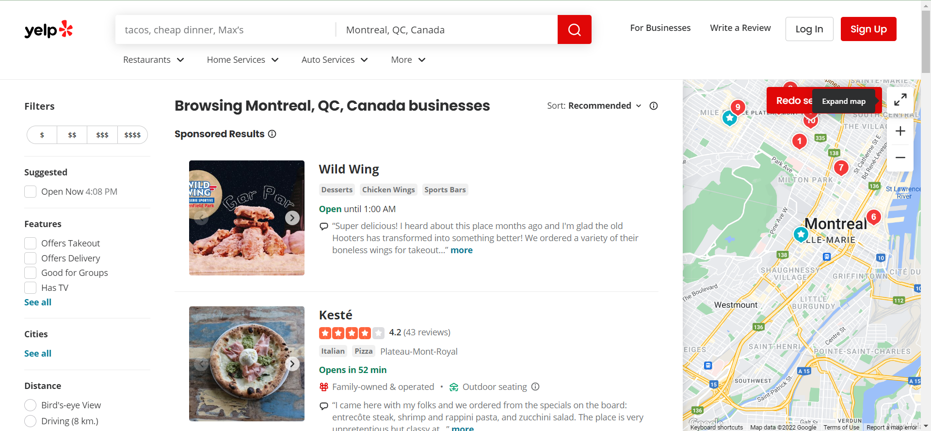
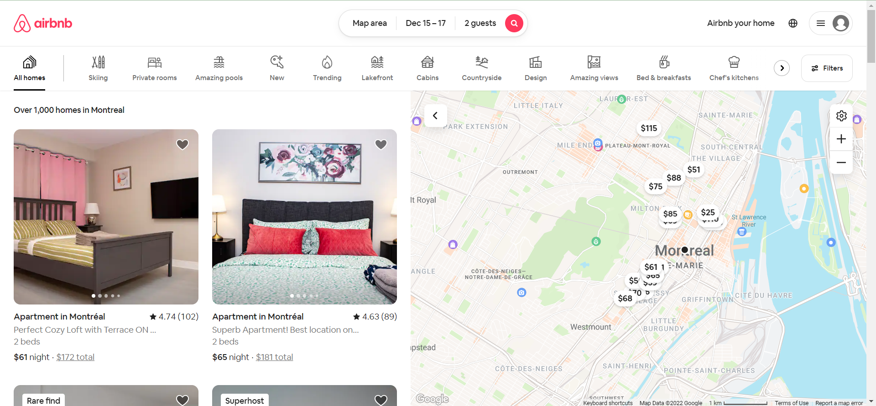
Problems & Related Work & Inspiration
Can we combine these two maps together in a dashboard?
Zayn traveled to Montreal several times. When he was staying in the city, he had a great time at Airbnb but missed out on some cool locations. Therefore, we wanted to create a dashboard that helps people plan their stays and maximize their fun in the city!
Could you select an Airbnb with more than just your location and price in mind? What can you do around your stay within your desired distance?
Related Work: Workbooks about how to create cool maps in class.
Inspiration: This fantastic Singapore Airbnb dashboard.

Slide 4

Data Process
Data Source:
Airbnb data: insideairbnb.com
yelp data: yelp.com
Data Size:
listing.csv: 13622 rows x 75 columns
business.csv: 5958 rows x 9 columns
reviews.csv: 326826 rows x 6 columns
calendar.csv: 4971666 rows x 7 columns
listing_id
listing.csv
reviews.csv
listing_id
Data Manipulations:
Drop irrelevant columns for each data table (urls, long text)
Select 4 months of calendar data
Blend Airbnb listing data with yelp business data
Add a new column specifying the kind of property (Airbnb or yelp)
Join new Airbnb listing data, Airbnb reviews and calendar data on listing_id in Tableau
business.csv
calendar.csv

Slide 5
Exploratory Data Analysis
We initially plotted several maps, bar charts and line chars at neighborhood, hosts, and specific listing levels
Insights & Actions:
Different districts have different performance in each measure. For most of the time, district that is near to downtown has higher performance scores. We added a map in the dashboard to allow user to choose their desired neighborhood to grab information on a higher level
The top 5 neighborhoods with most listings are about half of all listings in Montreal
The response rate and time varies a lot between superhosts and non-superhosts. We developed box plot to see score distribution difference between these two groups.
The average rating of Superhosted Airbnbs is higher and the range of scores given to Superhosts is lower
The restaurants are located in several main areas near downtown, and it is more convenient to go to fun places if choosing to live in downtown area

Slide 6
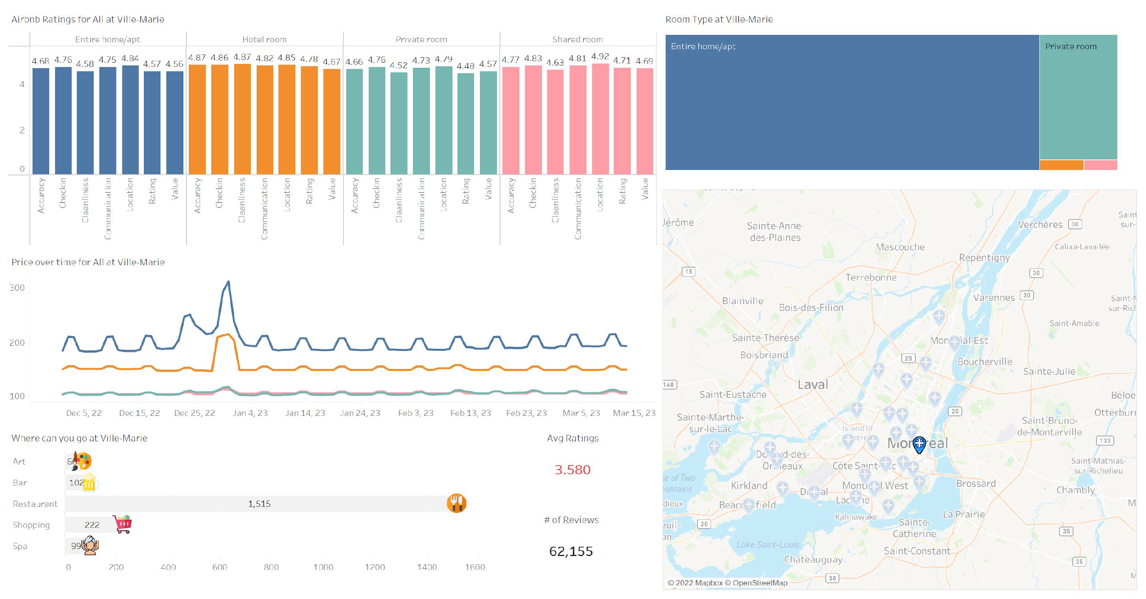
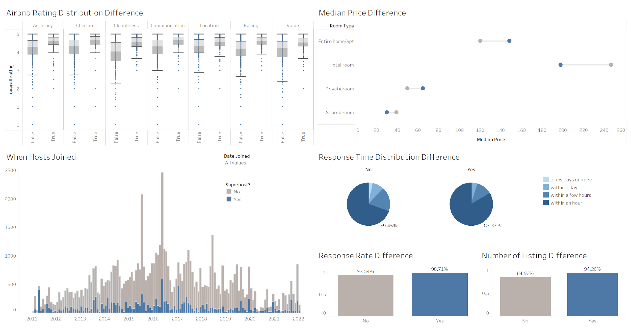
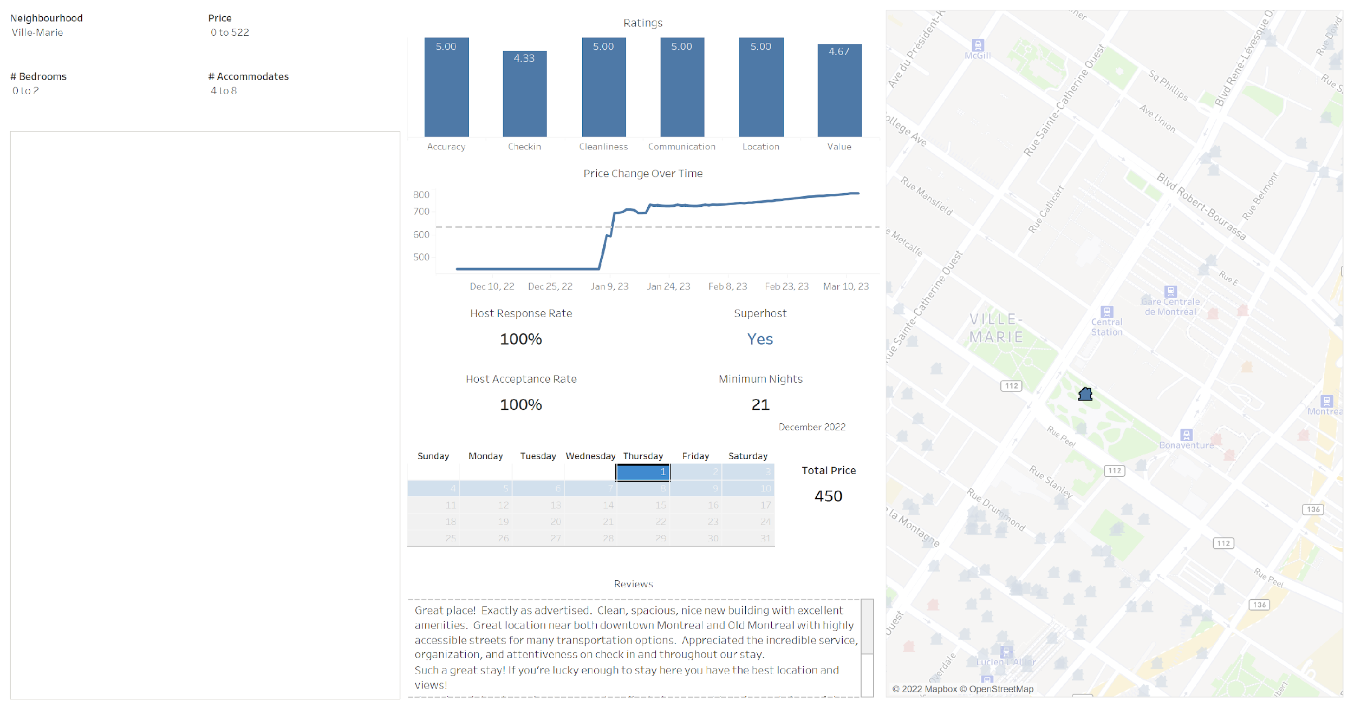
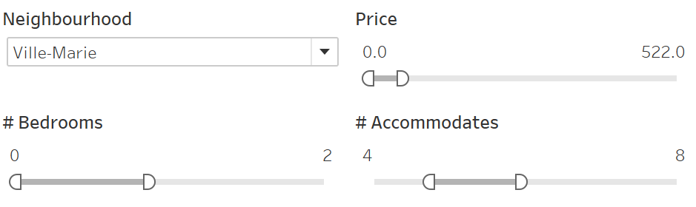
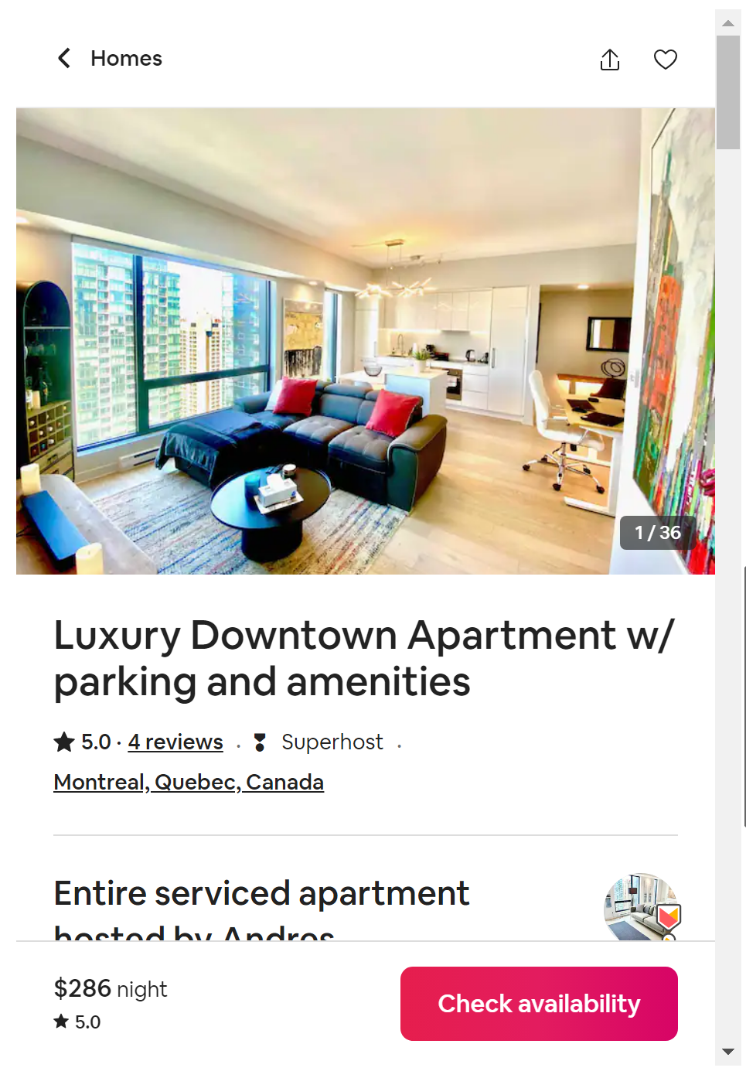
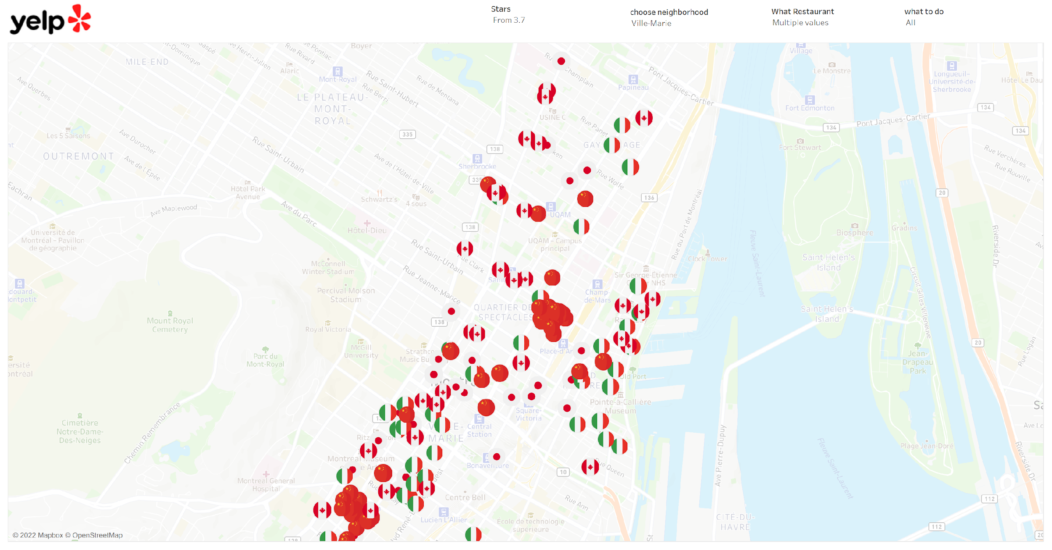
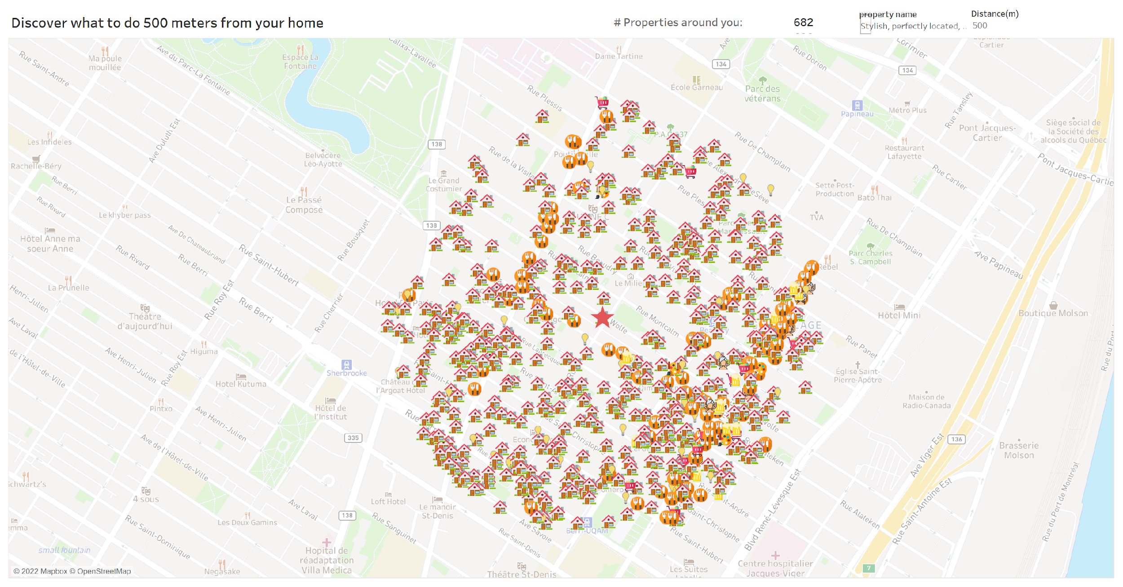
Implementation

Slide 7
Dashboard Overview
Neighborhood Analysis:
Number of Airbnb for different room types in a chosen district
Various Airbnb ratings for different room types in a chosen district
Average yelp starts, number of reviews and number of yelp places by category in a chosen district
Choose Your Airbnb:
Get the desired Airbnb based on the bedroom, accommodates, price, and neighborhood filters
View the Airbnb rating, price fluctuation, host response rate, host acceptance rate, if it is a superhost, minimum booking nights, reviews of a chosen Airbnb location
View the total price (including all fees) on chosen dates on the calendar filter
View the Airbnb webpage of the chosen Airbnb
Host Analysis:
Number of Hosts joined from 2011 to 2022 by superhosts
Airbnb rating distribution difference between superhosts and non-superhosts
Median price, response time, response rate, and number of listing difference between superhosts and non-superhosts
Discover Nearby:
Choose your target Airbnb on the map and see other Airbnb and fun places within the desired distance
Hover on the dot and see the exact distance in the tooltip
Select the fun place or type in the name of it to see where you can stay around it
Yelp Recommendation:
Filter desired fun places by category and by neighborhood
Filter desired restaurants by type (Asian, Canadian, Indian, etc.)
Directly search what you want to do (breakfast, night life, café, etc.)

Slide 8

Neighborhood Analysis
Filter 2: Select room type on this tree map
The icon on the map is the flag of the Province of Québec of Canada
Red font means it is above the average, otherwise it is below the average
Filter 1: Select neighborhood on this map
Filter 3: Select the category of fun places to see the avg ratings and # of reviews

Slide 9
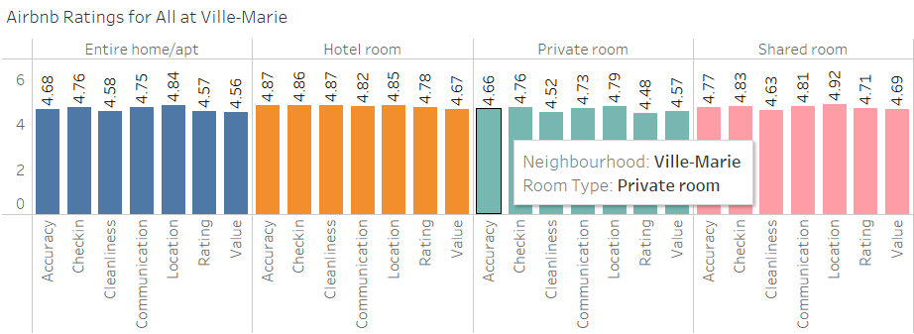
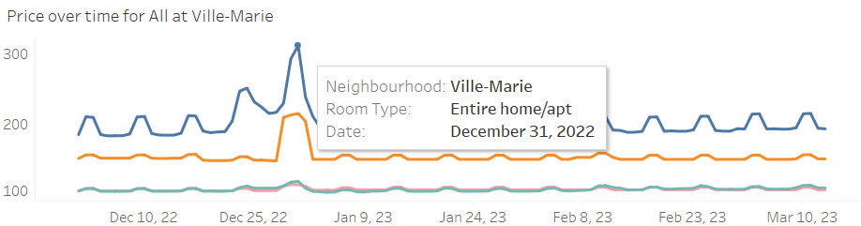
Neighborhood Analysis
This bar chart shows the different ratings of different room types in a specific region. The user will see how Airbnb perform on a higher level across different room types.
This line graph illustrates the average price by time in the selected district. You can compare prices among different room types and see how prices fluctuate in the future 4 months.

Slide 10
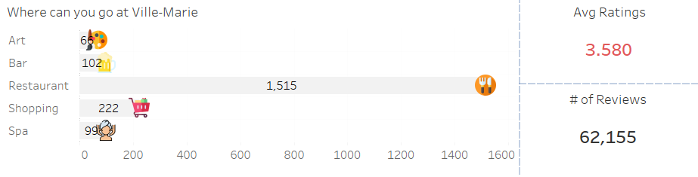
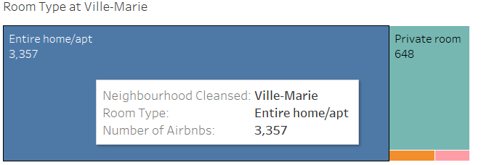
Neighborhood Analysis
The chart on the left is the dual axis of one bar chart and one point chart with customized shapes. It shows the number of places by category in the selected district. The average rating and number of reviews is the summary of the selected district, and if the user click the bar of the left graph, it will show the average rating and number of reviews for that specific category. Moreover, if the font of average ratings is red, it means the figure is over the city average, if it is in gray, it means it is below the city average.
This tree map shows the number of different room types in a specific district. It is also the filter to show detailed information on the other charts in this dashboard.

Slide 11
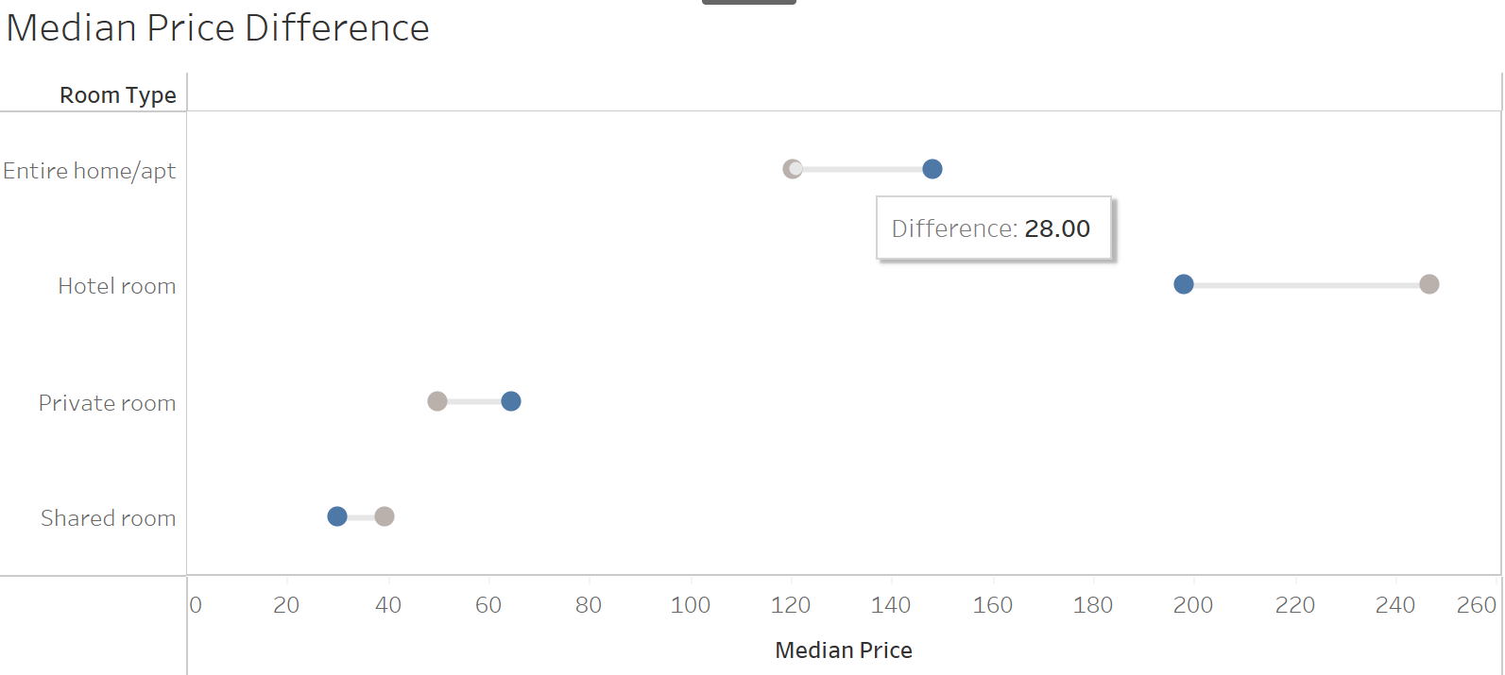
Host Analysis
Hover on the line to see the difference of median price between superhost and non-superhost
Hover on either bar in the three chars on the bottom to highlight all superhost or non-superhost data in this dashboard

Slide 12
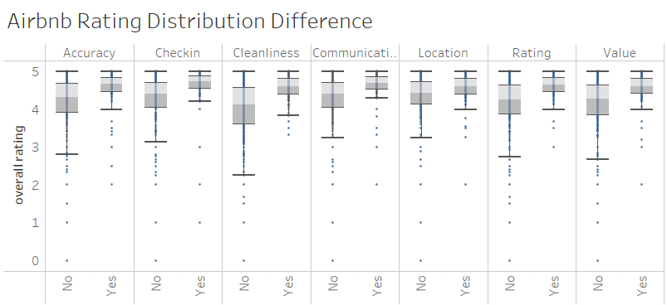
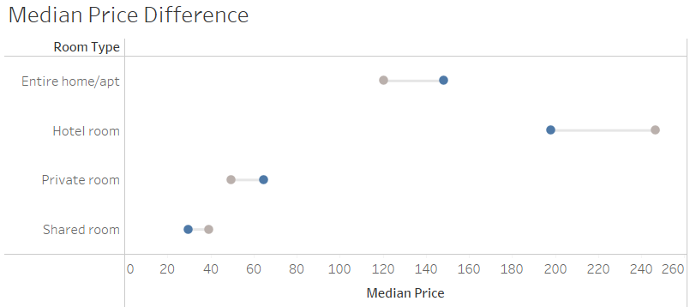
Host Analysis
The boxplot illustrates the score distribution of different ratings of superhost and non-superhost. This will tell the user the importance of choosing a superhost in Montreal.
The dumbbell chart shows how the listing price of superhost and non-superhost differs by different room type. When the user hover on the line between two dots, he will be able to see the value of difference.

Slide 13
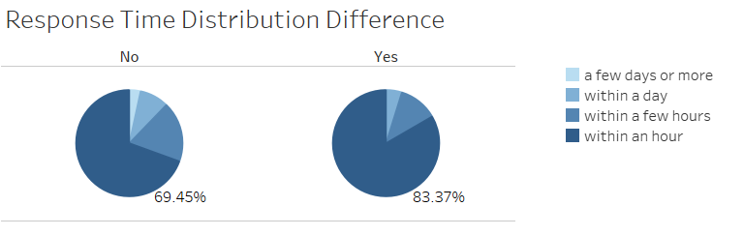
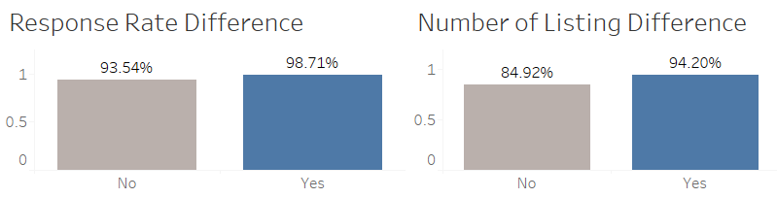
Host Analysis
Although the pie chart is not recommended for most of the time, we think it valuable to see the proportion of hosts that respond rapidly (within an hour). It will also let the user know the advantage of superhosts.
These two bar charts illustrate the better performance of superhosts in terms of response rate and total number of listing.

Slide 14
Choose Your Airbnb
Filter 2: Select your desired property on the map
Filter 1: Filter out properties that meet your requirements
The dash reference line shows the average price
Filter 4: Change the month
Filter 3: Select or multiselect the date on the calendar to get the total price of your stay
If the color is blue, it means it is available on this day, otherwise, it is unavailable

Slide 15
Yelp Recommendation
Click and see more fun places on the yelp website
Filter 4: type in what you want to do and see where it locates (café, sushi, etc.)
Filter 1,2,3: Choose the star rating for the place, its neighborhood and what type of restaurant it is

Slide 16
Discover Nearby
From calculated field WINDOW_COUNT(COUNT([Name]))-1, showing the total number of properties around the target.
Parameter 1: The map will automatically show all the properties within the desired distance.
The title will change as Distance changes
Parameter 1: By typing in the property name, the property will be selected as your target and then the system will count the distance from other properties to it. You can also menu select the property as your target on the map.

Slide 17
Insights & Self Evaluation
Insights:
Downtown Montreal tends to have more Airbnb and fun places, and they are closer to each other. The ratings for both are higher than those in the peripheral area. The price for Airbnb is also higher in the core area.
Superhosts have higher score ratings than non-superhosts. Their properties prices are also higher if it is entire apartment unit or private room unit.
Superhosts tend to reply faster and have a higher chance of accepting the stay request. They also have a larger number of listings.
Hosts are more likely to join Airbnb platform during the summer, and 2015-2017 is a peak of joining.
Future Improvements:
In the future we could increase the size of the dataset and have more time in the calendar. We could do this by implementing a cloud-based storage, but we wouldn't want it to get too huge and lose functionality of the dashboards
We could implement similar dashboards for other cities however we believe that adding more cities to this dashboard would create problems due to the size of the data and distract from the great city of Montreal
Self Evaluation:
We learned a lot as we were able to implement features such as our distance parameter to select close listings to selected listings and the calendar selection to select potential dates for stays and see price with fees included
We were able to implement our Viz as we hoped, giving users access to increased info before booking their stay
Time will tell if our Viz revolutionizes the way users select their Airbnb and plan their travel to Montreal
We think our Viz works Very Well!!
We learned that we all have a burning love for the country of Canada and the city of Montreal!

Slide 18
Thank you for your listening! Questions?

